Slide 1

INTRODUCTION TO STATISTICAL DATA ANALYSIS USING R & RSTUDIO
LUMUMBA WANDERA VICTOR
(M.Sc. Applied Statistics)
17th February, 2025
.

Slide 2
Session 3: Data Manipulation with dyply
Introduction to dplyr R package
dplyr is a powerful and efficient R package for data manipulation and transformation. It is part of the tidyverse ecosystem and provides a set of intuitive functions that make it easy to work with data frames and tibbles. dplyr is designed to handle large datasets efficiently and follows a grammar of data manipulation using functions called verbs.
Key Features of dplyr
Simple syntax: Uses human-readable functions that make code easy to understand.
Optimized performance: Uses C++ backend for faster computations.
Works with multiple data sources: Supports data frames, tibbles, and databases.
Chainable operations: Uses the pipe operator (%>%) to perform multiple operations in sequence.
2/8/2025
CENTER FOR DATA ANALYTICS AND MODELING, CHUKA UNIVERSITY
2

Slide 3
Session 3: Data Manipulation with dyply
Introduction to dplyr R package
Core dplyr Verbs (Functions)
The package provides key functions (verbs) that facilitate data manipulation:
filter() – Selects rows based on conditions.
select() – Selects specific columns.
mutate() – Creates or modifies new variables.
arrange() – Sorts rows based on column values.
summarise() – Aggregates data using summary statistics.
group_by() – Groups data to perform grouped operations.
join() – Merges datasets (e.g., left_join(), inner_join()).
2/8/2025
CENTER FOR DATA ANALYTICS AND MODELING, CHUKA UNIVERSITY
2

Slide 4
Session 3: Data Manipulation with dyply
Introduction to dplyr R package
filter() Function
The filter() function in dplyr is used to subset rows of a data frame (or tibble) based on specified conditions. It allows users to extract only the rows that meet certain criteria, making it useful for data exploration, cleaning, and preprocessing.
Key Features of filter()
Condition-Based Row Selection
Filters rows where conditions are TRUE, removing others.
Multiple Conditions
Allows filtering using multiple conditions combined with logical operators (&, |, !).
Works with Relational and Logical Operators
Supports operators like ==, !=, <, >, <=, >=.
Works Well with Pipe (%>%)
Can be used in sequence with other dplyr functions.
2/8/2025
CENTER FOR DATA ANALYTICS AND MODELING, CHUKA UNIVERSITY
2

Slide 5
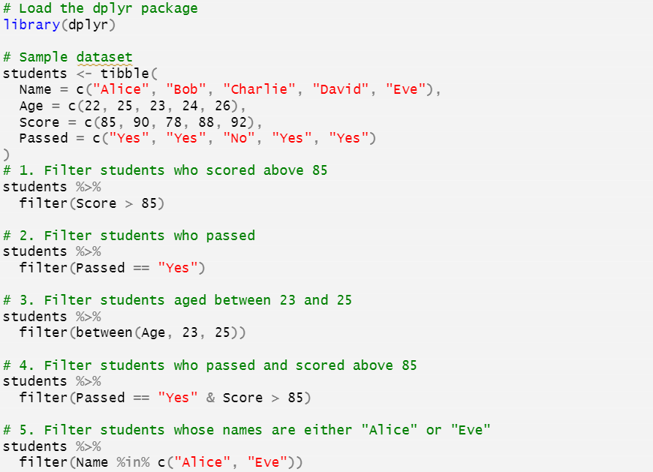
Session 3: Data Manipulation with dyply (Sample R code for filter()
2/8/2025
CENTER FOR DATA ANALYTICS AND MODELING, CHUKA UNIVERSITY
2

Slide 6
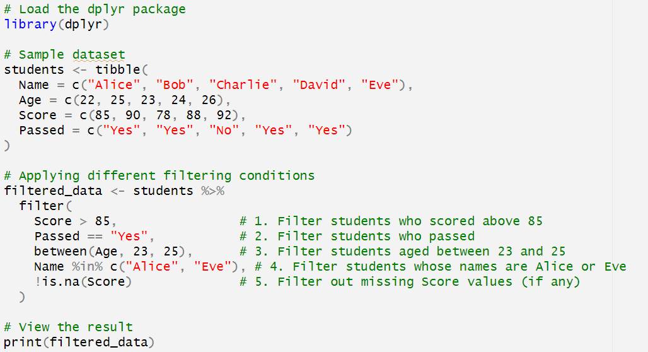
Session 3: Data Manipulation with dyply (Sample R code for filter()
2/8/2025
CENTER FOR DATA ANALYTICS AND MODELING, CHUKA UNIVERSITY
2

Slide 7
Session 3: Data Manipulation with dyply
Introduction to dplyr R package
select() Function
The select() function in dplyr is used to choose specific columns from a dataset. It helps in reducing unnecessary variables and improving readability, efficiency, and performance when working with large datasets.
Key Features of select()
Column Selection
Extracts specific columns based on names or positions.
Exclusion of Columns
Removes unwanted columns using - (minus sign).
Selection Using Helper Functions
Allows pattern-based column selection.
Works with Pipe (%>%)
Easily combined with other dplyr functions.
2/8/2025
CENTER FOR DATA ANALYTICS AND MODELING, CHUKA UNIVERSITY
2

Slide 8
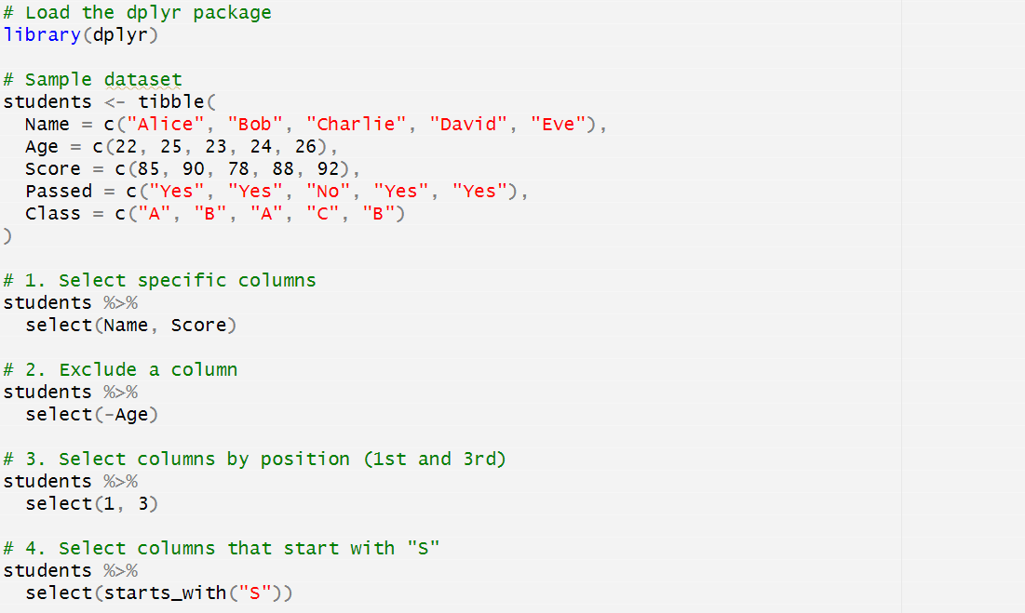
Session 3: Data Manipulation with dyply (select() function R code
2/8/2025
CENTER FOR DATA ANALYTICS AND MODELING, CHUKA UNIVERSITY
2

Slide 9
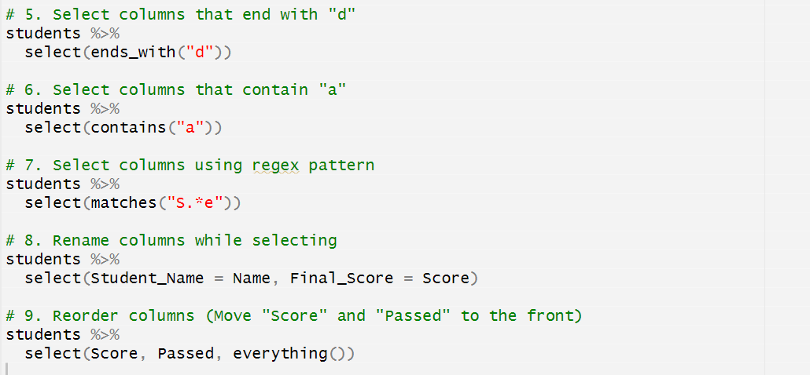
Session 3: Data Manipulation with dyply (More select() functions
2/8/2025
CENTER FOR DATA ANALYTICS AND MODELING, CHUKA UNIVERSITY
2

Slide 10
Session 3: Data Manipulation with dyply (More select() functions
Conclusion
The select() function is an essential tool for column manipulation in R. It allows for flexible and efficient column selection, renaming, reordering, and exclusion. Using helper functions like starts_with(), contains(), and everything(), users can quickly refine datasets for analysis.
2/8/2025
CENTER FOR DATA ANALYTICS AND MODELING, CHUKA UNIVERSITY
2

Slide 11
Session 3: Data Manipulation with dyply: Mutate
The mutate() function in dplyr is used to create new columns or modify existing ones in a dataset. It allows users to perform calculations, transformations, and feature engineering while keeping the original dataset structure intact.
Key Features of mutate()
Creating New Columns
Generates new variables based on existing ones.
Modifying Existing Columns
Overwrites column values with updated calculations.
Multiple Column Transformations
Supports multiple operations in a single call.
Conditional Mutations with if_else() or case_when()
Enables logic-based transformations.
Use with transmute()
Similar to mutate(), but returns only the mutated columns.
2/8/2025
CENTER FOR DATA ANALYTICS AND MODELING, CHUKA UNIVERSITY
2

Slide 12
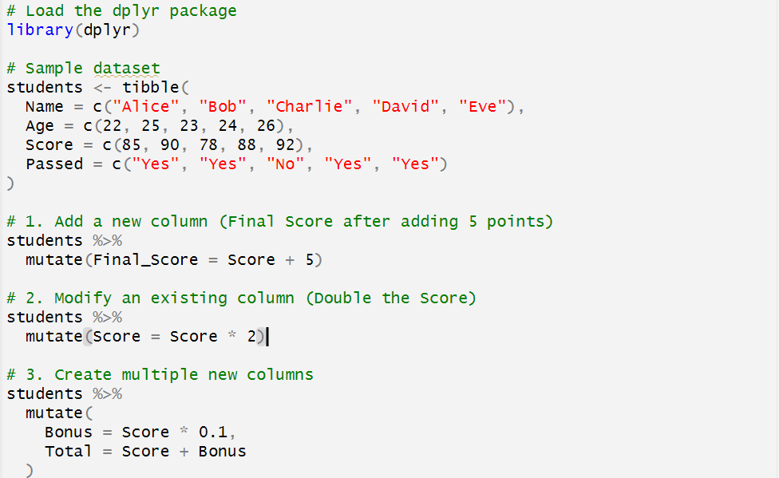
Session 3: Data Manipulation with dyply: Mutate
2/8/2025
CENTER FOR DATA ANALYTICS AND MODELING, CHUKA UNIVERSITY
2

Slide 13
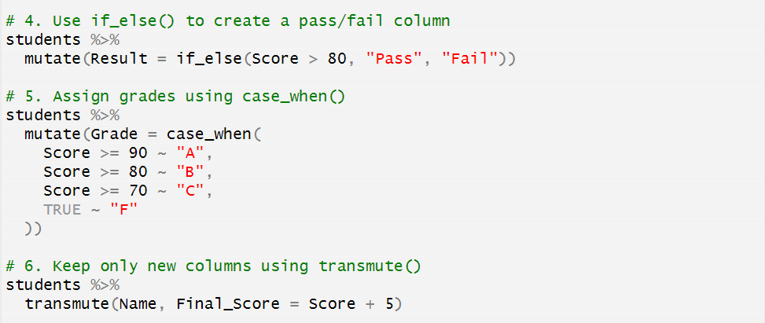
Session 3: Data Manipulation with dyply: Mutate
2/8/2025
CENTER FOR DATA ANALYTICS AND MODELING, CHUKA UNIVERSITY
2

Slide 14
Session 3: Data Manipulation with dyply: Mutate
Conclusion
The mutate() function in dplyr is a powerful tool for data transformation.
It enables the creation of new variables, modification of existing ones, and
conditional computations. For cases where only the transformed columns are
needed, transmute() is a great alternative.
2/8/2025
CENTER FOR DATA ANALYTICS AND MODELING, CHUKA UNIVERSITY
2

Slide 15
Session 3: Data Manipulation with dyply: Arrange
The arrange() function in dplyr is used to sort rows of a dataset based on one or more columns. Sorting can be done in ascending (default) or descending order. It is useful for organizing data for better readability and analysis.
Key Features of arrange()
Sorts Data in Ascending Order (Default)
Orders rows from smallest to largest.
Sorts Data in Descending Order
Uses desc() to reverse the order.
Sorts by Multiple Columns
Prioritizes sorting based on multiple variables.
Handles Missing Values (NA)
Places NA values at the end by default.
Compatible with Piping (%>%)
Works well with other dplyr functions.
2/8/2025
CENTER FOR DATA ANALYTICS AND MODELING, CHUKA UNIVERSITY
2

Slide 16
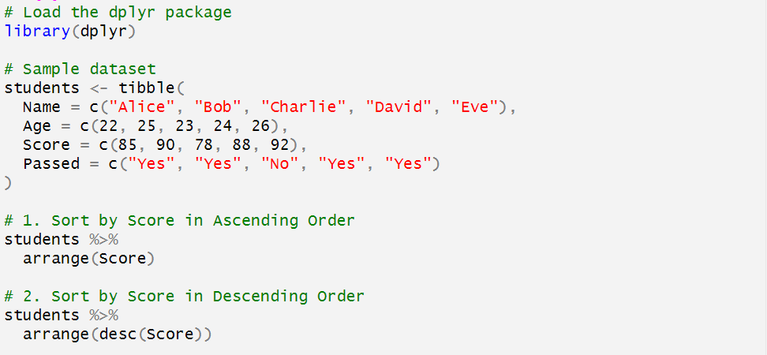
Session 3: Data Manipulation with dyply: Arrange
2/8/2025
CENTER FOR DATA ANALYTICS AND MODELING, CHUKA UNIVERSITY
2

Slide 17
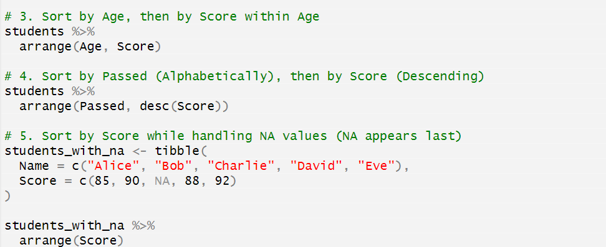
Session 3: Data Manipulation with dyply: Arrange
2/8/2025
CENTER FOR DATA ANALYTICS AND MODELING, CHUKA UNIVERSITY
2

Slide 18
Session 3: Data Manipulation with dyply: Arrange
Conclusion
The arrange() function in dplyr is essential for sorting datasets in R. It provides flexibility
with ascending and descending orders, supports multiple column sorting, and handles
missing values efficiently. It is particularly useful when preparing datasets for visualization
or further analysis.
2/8/2025
CENTER FOR DATA ANALYTICS AND MODELING, CHUKA UNIVERSITY
2

Slide 19
Session 3: Data Manipulation with dyply: Summarize
The summarize() function (or summarise(), the British spelling) in dplyr is used to compute summary statistics for a dataset. It reduces multiple rows into a single row (or a smaller subset) by applying aggregation functions like mean, sum, count, min, max, and more.
Key Features of summarize()
Computes Aggregate Statistics
Performs calculations such as mean, sum, count, min, max, etc.
Reduces Rows
Converts multiple rows into summarized values.
Works with group_by()
Summarizes data for each group separately.
Supports Multiple Summary Operations
Allows multiple calculations in one call.
Compatible with Other dplyr Functions
Works well with mutate(), filter(), arrange(), etc.
2/8/2025
CENTER FOR DATA ANALYTICS AND MODELING, CHUKA UNIVERSITY
2

Slide 20
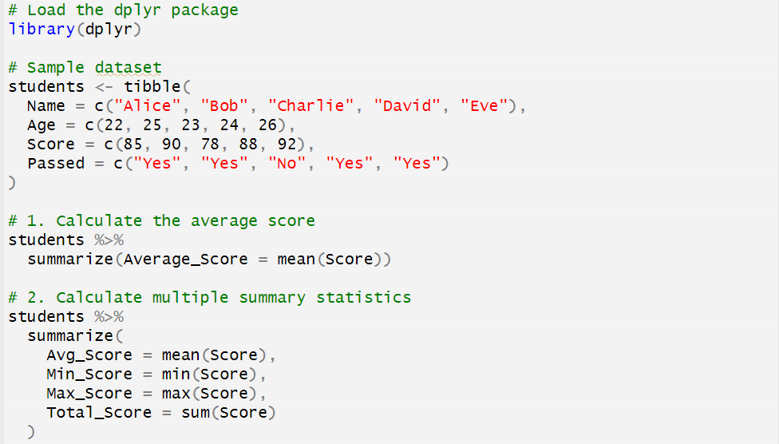
Session 3: Data Manipulation with dyply: Summarize
2/8/2025
CENTER FOR DATA ANALYTICS AND MODELING, CHUKA UNIVERSITY
2

Slide 21
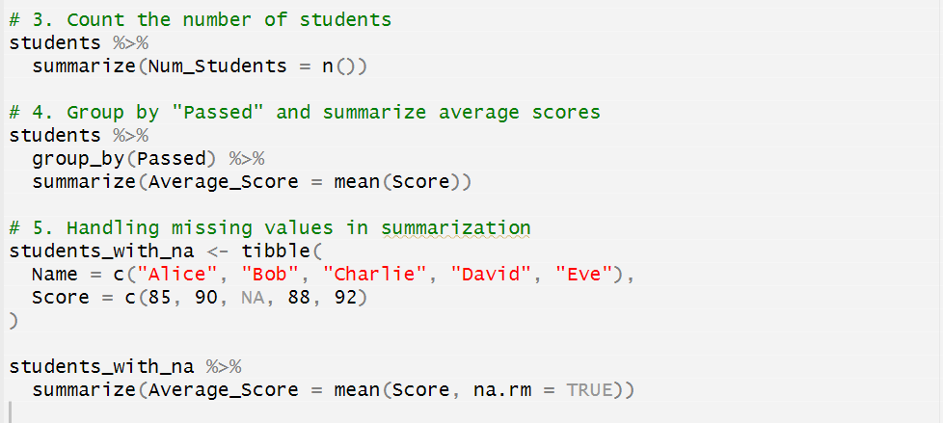
Session 3: Data Manipulation with dyply: Summarize
2/8/2025
CENTER FOR DATA ANALYTICS AND MODELING, CHUKA UNIVERSITY
2

Slide 22
Session 3: Data Manipulation with dyply: Piping (%>%)
Introduction to Piping (%>%) in R
Piping (%>%) is a core feature of the tidyverse, introduced by the magrittr package and widely used in dplyr.
It is a way to improve code readability by allowing sequential operations without nesting functions inside each other.
What is Piping (%>%)?
The pipe operator %>% takes the output of one function and passes it as the first argument to the next function.
This makes the code more readable and reduces the need for intermediate variables
2/8/2025
CENTER FOR DATA ANALYTICS AND MODELING, CHUKA UNIVERSITY
2

Slide 23
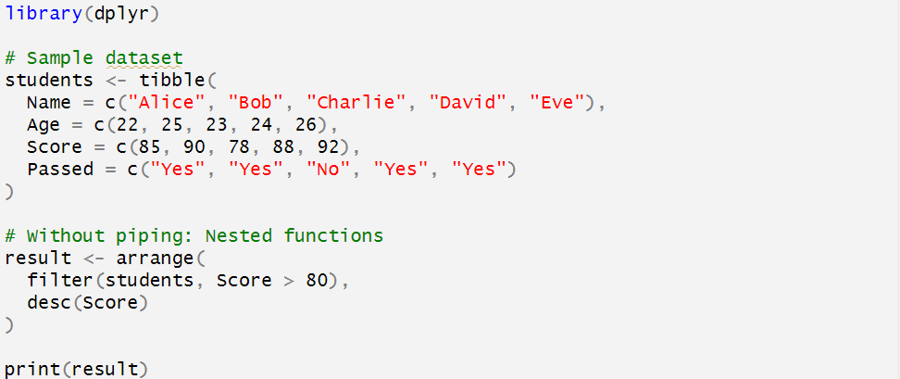
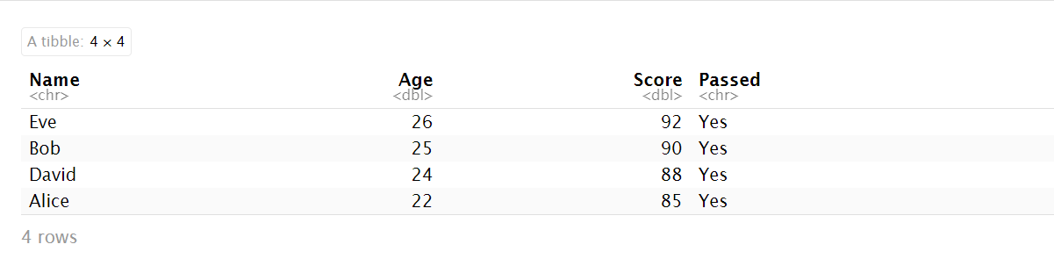
Session 3: Data Manipulation with dyply: Piping (%>%)
2/8/2025
CENTER FOR DATA ANALYTICS AND MODELING, CHUKA UNIVERSITY
2

Slide 24
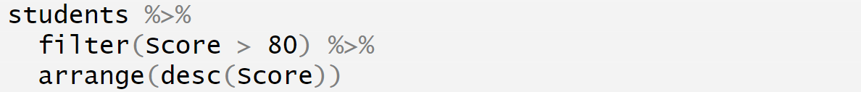
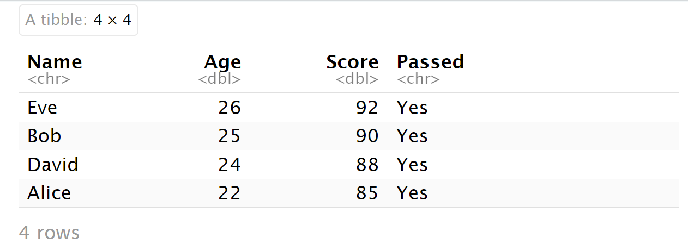
Session 3: Data Manipulation with dyply: Piping (%>%)
2/8/2025
CENTER FOR DATA ANALYTICS AND MODELING, CHUKA UNIVERSITY
2

Slide 25
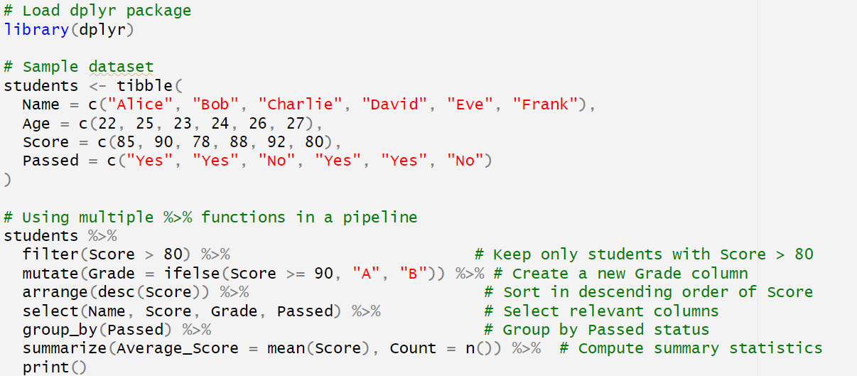
Session 3: Data Manipulation with dyply: Multiple Piping (%>%)
2/8/2025
CENTER FOR DATA ANALYTICS AND MODELING, CHUKA UNIVERSITY
2

Slide 26

Session 3: Data Manipulation with dyply: Results of Multiple Piping (%>%)
2/8/2025
CENTER FOR DATA ANALYTICS AND MODELING, CHUKA UNIVERSITY
2

Slide 27
Session 3: Data Manipulation with dyply (%>%)
2/8/2025
CENTER FOR DATA ANALYTICS AND MODELING, CHUKA UNIVERSITY
2

Slide 28

https://cdam.chuka.ac.ke
Thank you
2/8/2025
CENTER FOR DATA ANALYTICS AND MODELING, CHUKA UNIVERSITY

